Slide 1
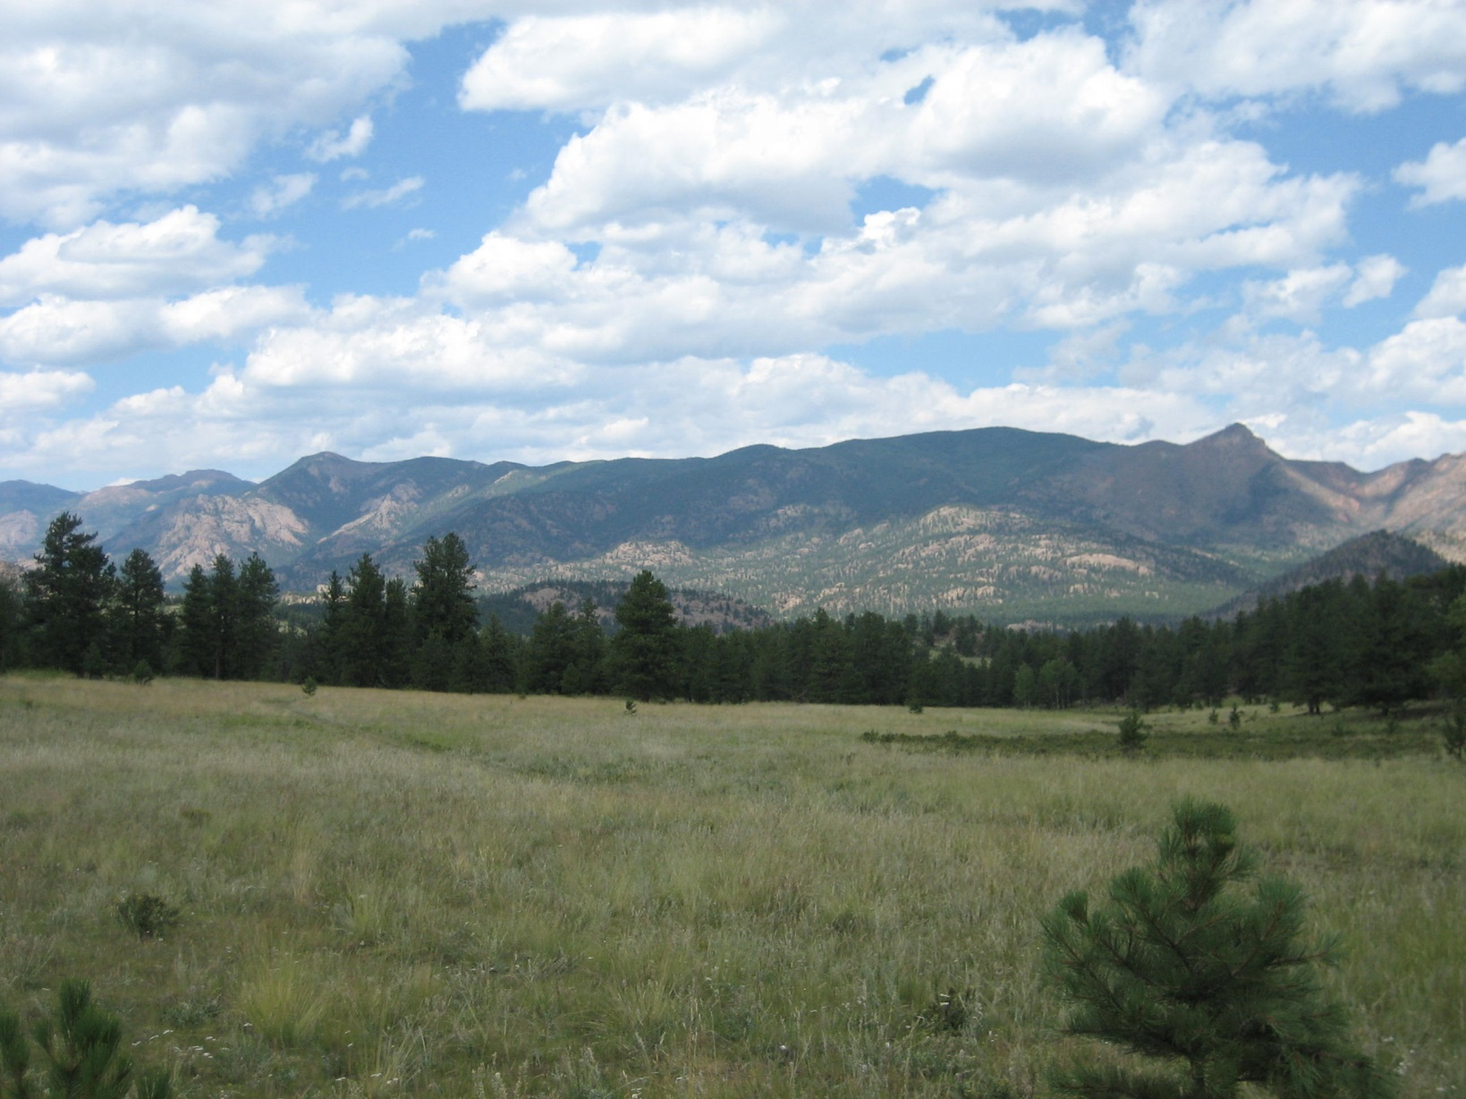
Rabies
By Dr. Victoria J. Cabrera DVM

Slide 2
Rabies
Is a lethal encephalitis cause by a virus in the family Rhabdoviridae genus Lyssavirus
Exposure occurs through the bite wound of an infected animal, typically wildlife such as raccoon, fox, skunk, or bat.
Two genotypes
Classic raccoon, skunk, fox, etc.
Bat Variant
Bites to horses most often occur on the muzzle, face, and lower limbs.
The virus migrates via nerves to the brain where it initiates a rapidly progressive, invariably fatal encephalitis.
Notes:
I have had a lot of questions about rabies this year.

Slide 3
Rabies
Prior to 2006 in Colorado the primary reservoir for rabies was in the bat population.
However since 2007 there has been a rise in rabies found in skunks especially this year.
Skunks are highly efficient at transmitting rabies virus to other species
The state veterinarian is urging local veterinarians to help livestock /horse owners to discuss the best course of action to protect their animals from rabies.

Slide 4
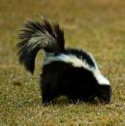
Rabies
The American Association of Equine Practitioners or AAEP changed is vaccine recommendations for horses.
Rabies is considered a core vaccine for all horses.
As skunk rabies spreads from the eastern plains toward the Front Range areas, the risk of rabies infection in livestock is increasing.

Slide 5
Colorado Rabies Map 2014

Slide 6
Common Risk Factors for Horses
Lives in an endemic area
No vaccinations
Young horses have a higher risk than old
Horse lives outside 24 hours a day
Notes:
Younger horses are more curious and tend to investigate things more than older horses

Slide 7
Who can get rabies?
Any mammal that is exposed to rabies can become infected with rabies.
Including horses, other domestic livestock
People!!!
Notes:
This is why it is a core vaccine now.

Slide 8
Clinical Signs Rabies
Extremely Variable
Early signs are not specific may start with a horse that is off feed, lethargic, symptoms of colic, or has a fever
Behavioral Changes, sensitivity to light and sound
Ataxia and In coordination
Progressing to Paresis and Paralysis

Slide 9
Rabies
Furious
Stuporous(dumb)
Less common
Animal may become excitable, fearful, enraged,
Self mutilation
May exhibit aggression
Hyperesthesia sensitivity to stimuli(light and sound)
Mental Depression
Off feed
Head Pressing
Circling
Flaccid tongue, tail, and hindquarters

Slide 10
Other diseases can look similar
Encephalitis viruses like Eastern and Western and West Nile Virus
Equine Herpes Virus
Hepatic Encephalopathy
Space occupying mass
Equine Protozoal Myelitis
Colic and other diseases

Slide 11
Diagnosis
No definitive ante mortem test is available in animals
Blood tests are not specific
CSF Analysis
May be normal
Xanthocromic (yellow color) and increased protein
Best test is post mortem
Fluorescent antibody test on brain tissue
Histopathology on brain tissue

Slide 12
Human Exposure to Rabies
Saliva and brain/nervous tissue are considered infectious material that can transmit rabies
Petting or handling an animal, or contact with blood, urine, or feces does NOT constitute an exposure.
Bite wounds should be IMMEDIATELY be washed with disinfectant soap and water, and a human physician should be contacted.

Slide 13
Treatment of Rabies in Animals
NO curative treatment
Euthanasia is recommended in animals exhibiting clinical signs of the disease.

Slide 14
Treatment of Rabies Exposure in people who are unvaccinated
Post Exposure Prophylaxis
5 doses of intramuscular vaccine given at day 0,3,7, 14, and 28 days.
Rabies Immunoglobulin
Infiltrated around bite wound or injected intramuscular one dose

Slide 15
Rabies Vaccinations
The national associations of state public health veterinarians recommends vaccination for all livestock with frequent contact with humans, and specifically horses that travel interstate.
Inactivated vaccines all induce a strong serologic response.

Slide 16
Rabies Vaccination
Foals from mares with unvaccinated or unknown vaccine history.
First dose should be administered at 3 to 4 months of age. Revaccinate annually thereafter.

Slide 17
Rabies Vaccination
Foals that are born from vaccinated mares
First dose of vaccine should be administered at 6 months of age.
A second dose is given 4 to 6 weeks later. Revaccinate annually thereafter.

Slide 18
Rabies Vaccination
Adult horses either previously unvaccinated or unknown vaccine history. Administer a single primary dose.
Revaccinate annually
Adult horses previously vaccinated against rabies
Administer one dose annually

Slide 19
What to do if your horse is bitten by a rabid animal
If they have been vaccinated
Revaccinate immediately
Observe for 45 to 90 days
If they have not been vaccinated
Euthanize
Isolate and observe for 6 months, if start to show signs euthanize.

Slide 20
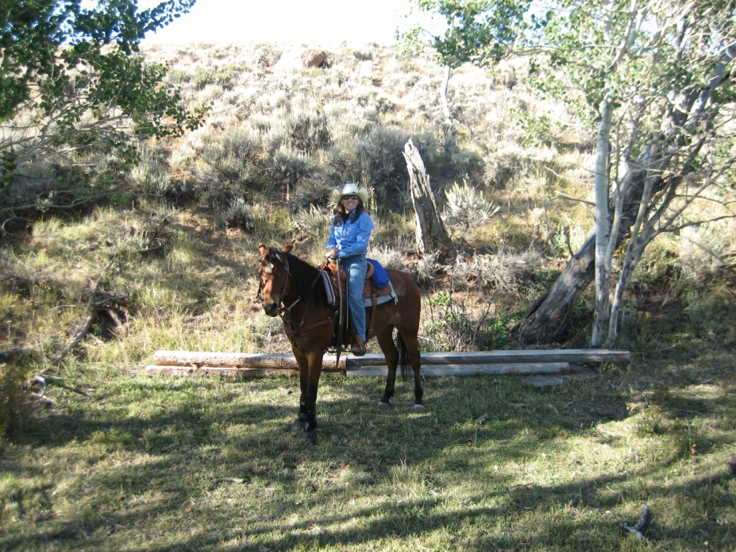
Animal Clinic, LLC
Please contact us at Animal Clinic 303-857-6671 if you have any questions or concerns about rabies.

Slide 21
Rabies
Photos courtesy of American Association of Equine Practitioners, Carrie Younger, and Jody Cabrera

